Slide 1
ACCEPTED AS SUBMITTED

Slide 2
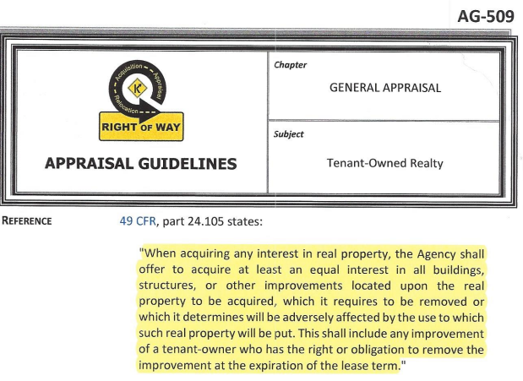
COMPANY OVERVIEW

Slide 3
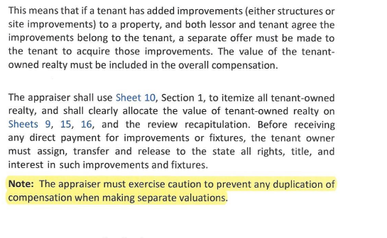
COMPANY OVERVIEW

Slide 4
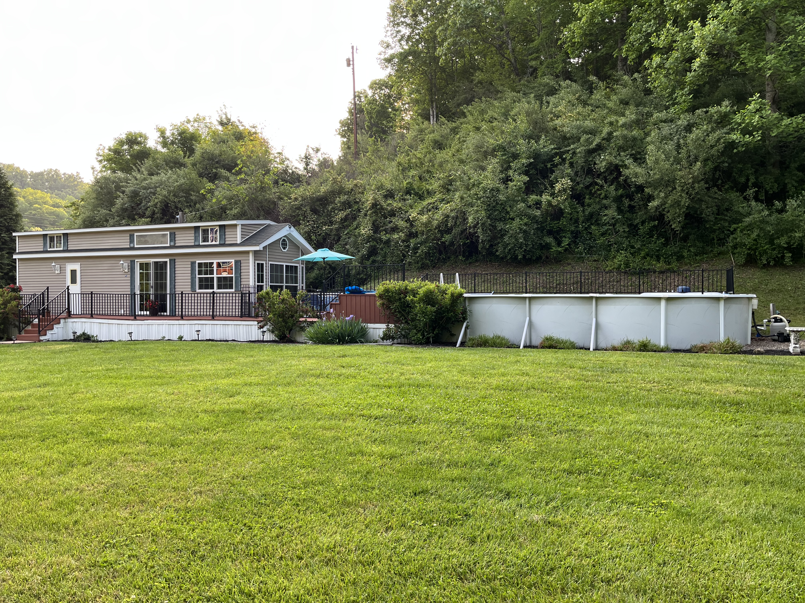
RESEARCH
ABSTRACT
DESIGN

Slide 5
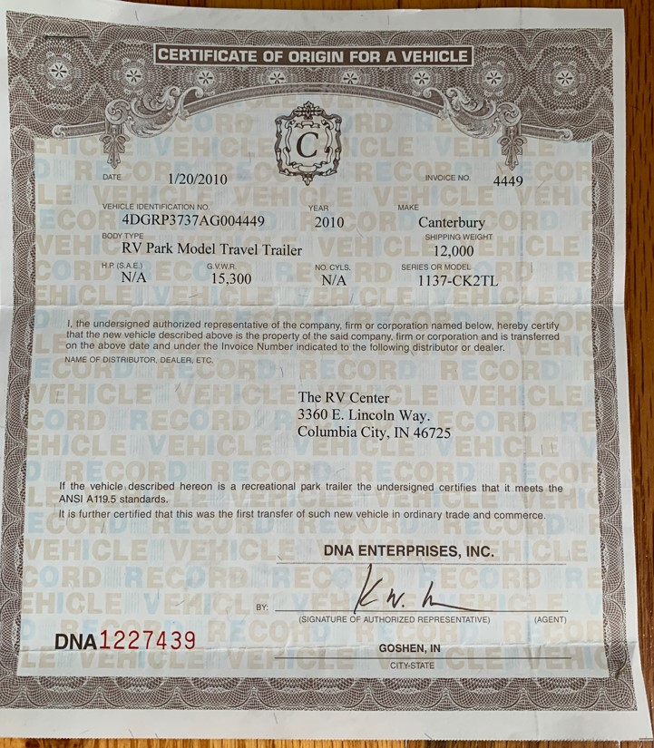
COMPANY OVERVIEW

Slide 6
COMPANY OVERVIEW

Slide 7
COMPANY OVERVIEW

Slide 8
COMPANY OVERVIEW

Slide 9
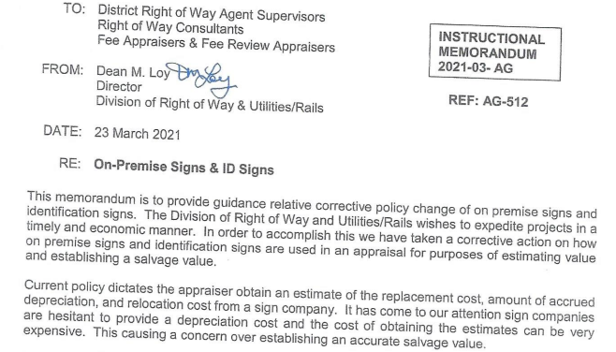
COMPANY OVERVIEW

Slide 10
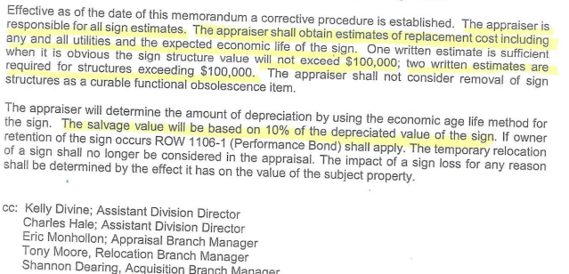
COMPANY OVERVIEW

Slide 11
COMPANY OVERVIEW

Slide 12
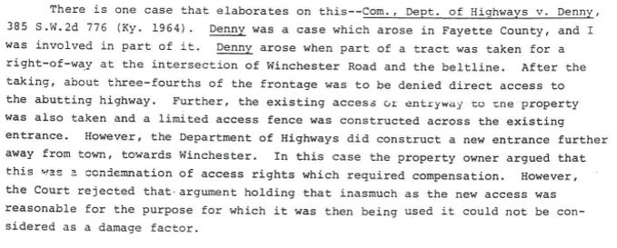
COMPANY OVERVIEW

Slide 13
COMPANY OVERVIEW

Slide 14
COMPANY OVERVIEW

Slide 15
COMPANY OVERVIEW

Slide 16
COMPANY OVERVIEW

